Slide 1
Coffee Shop Sales Analysis Dashboard Project
Challa Harika
Data Analyst Intern
Tools : Power BI, Excel, DAX, Power Query, Business Analysis

Slide 2
Business Problem : The business wanted to understand sales performance across months, stores, product categories, product types and transaction time.
Dataset: 149,116 Transactions

Slide 3
Data Preparation & Modelling
Data Types : I assigned appropriate data types to each column—for example, transaction date as Date, transaction time as Time, quantity as Whole Number, and price/sales as Decimal Number.
Calculated Sales: Sales was calculated by multiplying transaction quantity × unit price.
Transaction Hour : I extracted the hour from the transaction time to analyse sales by hour, such as 7 AM, 8 AM, 9 AM, etc.
Date Table: I created a separate Date Table containing dates from January to June 2023 and connected it to the transaction table.
Time Intelligence: I used DAX time-intelligence functions to compare sales across different time periods, such as previous month, Month-over-Month (MoM), and Month-to-Date (MTD).

Slide 4
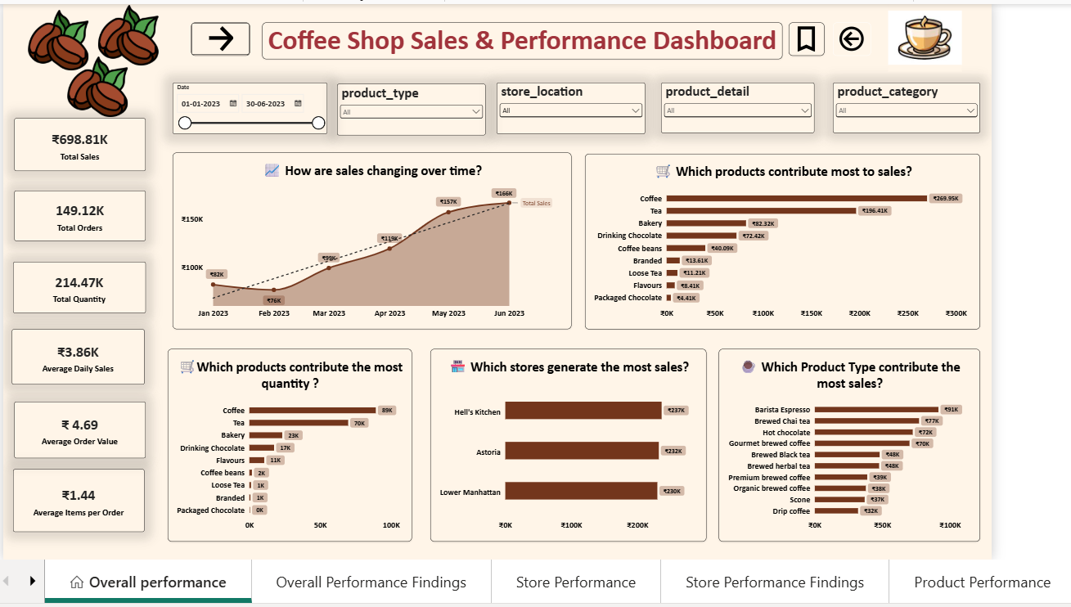
Overall Performance

Slide 5
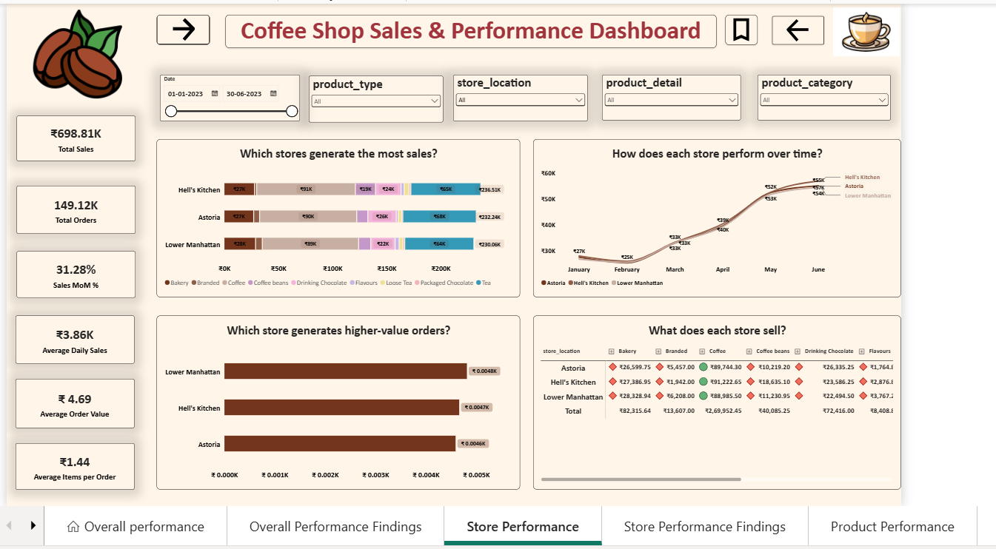
Store Performance

Slide 6
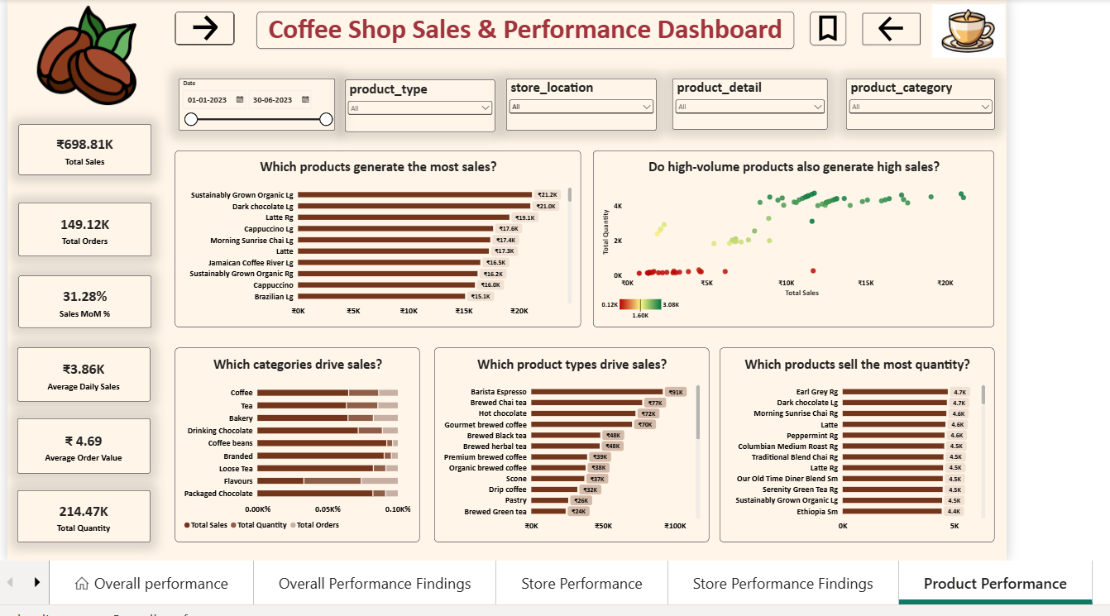
Product Performance

Slide 7
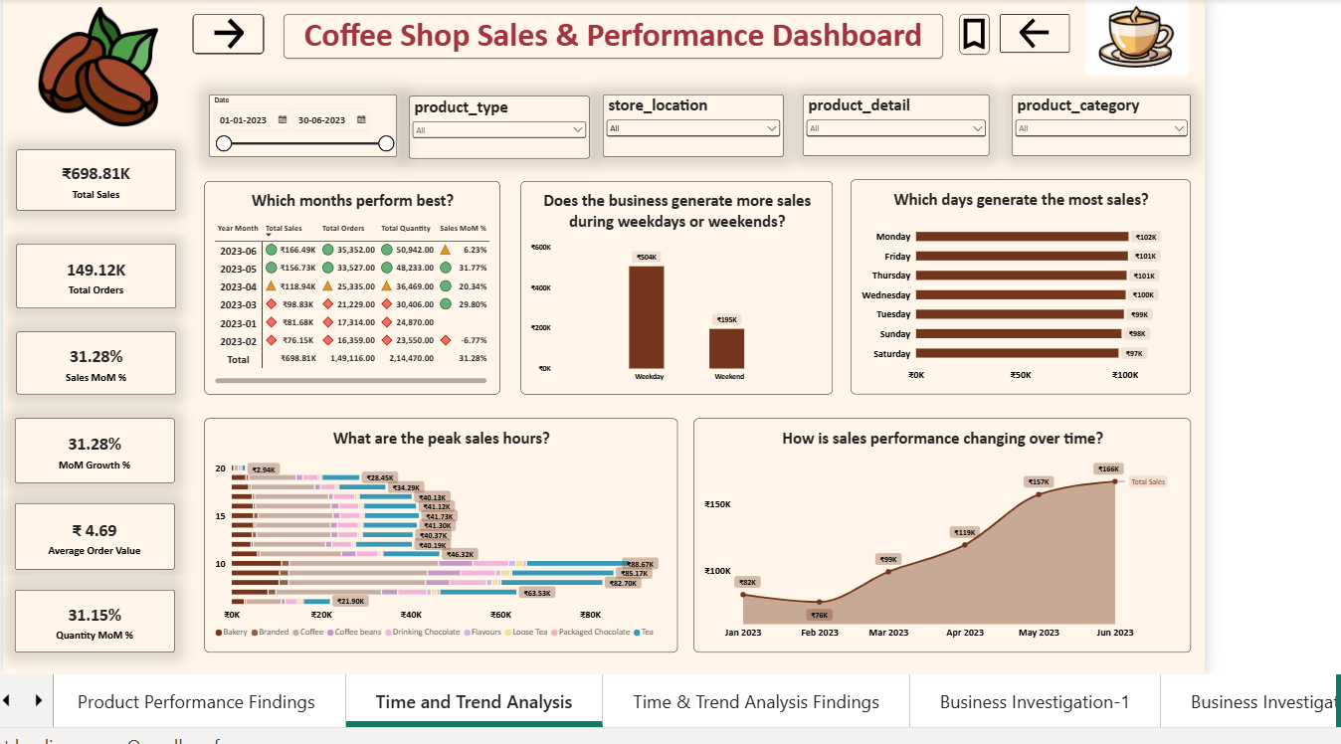
Time & Trend

Slide 8
Business Investigation
1. Why did sales increase sharply after February?
Sales increased sharply after February primarily because transaction volume and quantity sold increased substantially. Monthly sales rose from ₹76.15K in February to ₹166.49K in June, while orders increased from 16,359 to 35,352 and quantity increased from 23,550 to 50,942. This indicates that the growth was driven mainly by higher sales volume rather than a major increase in average order value.
2. Why is Astoria generating the lowest sales?
Astoria recorded the lowest total sales among the three stores. The lower sales level is associated with lower order volume and lower Average Order Value compared with the other store locations.
Further analysis of product mix and hourly sales is required to determine whether differences in customer demand, product mix, or trading hours contribute to the gap.
3. Are high-value products underperforming?
Coffee and Tea are major sales- generating categories and both recorded positive MoM growth. Coffee generated approximately ₹91.2K with 31.81% MoM growth, while Tea generated approximately ₹64.7K with 30.75% growth. Therefore, the available figures indicate positive momentum rather than category-level decline.
4. What are the peak sales hours?
Sales are concentrated in the morning, with the strongest performance occurring between approximately 8 AM and 10 AM. 10 AM is the peak sales hour at approximately ₹66K. Sales decline considerably during the later hours, reaching approximately ₹2.9K at 8 PM.
Sales at 7 PM were approximately ₹28.4K and declined further to approximately ₹2.9K by 8 PM.
5. Which products sell during peak hours?
During the peak morning period, multiple product categories contribute to sales, with Coffee and Tea generating the largest sales contribution.
During the peak-hour period, Coffee generated approximately ₹33.3K and Tea approximately ₹23.0K, making them the strongest contributors among the analysed categories.

Slide 9
6. Which stores have strongest morning sales?
The 7 AM–10 AM period represents the strongest morning sales window. Store-level performance during this period should be compared to identify which location contributes most to morning demand.
7. Why are weekday sales much higher than weekend sales?
Weekday = ₹504K
Weekend = ₹195K
Customers spend much more on weekdays.
Weekdays generate ₹504K versus ₹195K on weekends, but the difference is largely influenced by the number of weekdays versus weekend days. On a daily basis, weekday sales are approximately ₹100.8K compared with ₹97.5K on weekends, indicating that daily sales are relatively similar, with only a modest weekday advantage.
Total weekday sales are higher primarily because there are more weekdays; average daily sales are relatively similar, with a modest weekday advantage.
8. Why is a product underperforming?
Dark Chocolate records relatively low sales alongside lower order volume and quantity compared with stronger-performing products. This suggests limited contribution to overall sales, but additional analysis of store availability and product demand is required before concluding that the product itself is unpopular.
9. Peak-Hour Opportunity
Finding: Morning hours represent the strongest sales period, with sales peaking at 10 AM. Coffee and Tea are the dominant categories during this period. Sales decline substantially toward the evening, reaching the lowest level at 8 PM.
Business interpretation: The morning sales concentration indicates that peak-hour product availability and operational capacity could be important factors for maximizing sales during high-demand periods.
10. Revenue Concentration
The top 10 products contribute approximately 79% of total sales, indicating a high concentration of revenue among a relatively small group of products.
Business Implication: The business may be significantly dependent on its leading products, making their availability and continued demand important to overall sales performance.

Slide 10
Key Business Insights
01 — Sales Recovery
Sales declined 6.77% in February but returned to positive MoM growth from March onward, with the strongest growth of 31.77% in May.
02 — Stable AOV
AOV remained within a narrow range of ₹4.65–₹4.72, suggesting that sales changes were more closely associated with order activity than major changes in average order value.
03 — Product Concentration
Top 10 Product Types contribute approximately 79% of total sales.
04 — Category Drivers
Coffee and Tea are the dominant sales categories across the stores. Barista Espresso is the leading individual product by sales.
05 — Store Performance
Hell's Kitchen generated the highest sales at approximately ₹236.51K, while Lower Manhattan recorded approximately ₹230.06K.
06 — Morning Demand
Sales are strongest around 8–10 AM, with 10 AM reaching approximately ₹66K, while sales fall sharply toward the evening.
07 — Evening Decline
Sales decrease from approximately ₹28.4K at 7 PM to ₹2.9K at 8 PM, indicating a substantial drop in late-evening demand.
08 — Product/Volume Relationship
Sales volume and revenue should be evaluated separately because high quantities do not necessarily indicate proportionally high sales revenue.

Slide 11
Business Recommendations
Recommendation 1
Monitor inventory availability for high- contributing Coffee and Tea product types during peak morning hours.
Recommendation 2
Analyse product-level demand and availability for lower-performing products before making assortment changes.
Recommendation 3
Use monthly sales and product-type performance as recurring KPIs to monitor whether the post-February growth trend continues.
Recommendation 4
Compare store-level hourly sales to determine whether peak-hour patterns differ by location before making store-specific operational decisions.

